Slide 1
PyBullet Tutorial
강영민
동명대학교

Slide 2
PyBullet Quickstart Guide
https://docs.google.com/document/d/10sXEhzFRSnvFcl3XxNGhnD4N2SedqwdAvK3dsihxVUA/edit#
Easy to use Python model for physics simulation
For robotics, games, visual effects and machine learning
With a focus on sim-to-real transfer
File formats
Urdf, sdf, mjcf…
Provides
Forward dynamics
Inverse dynamics
Forward and inverse kinematics
Collision detection
Ray intersection queries
Bullet physics SDK
Pybullet robotics
Simulated minitaur quadruped, humanoids running using Tensorflow inference and KUKA arms grasping objects

Slide 3
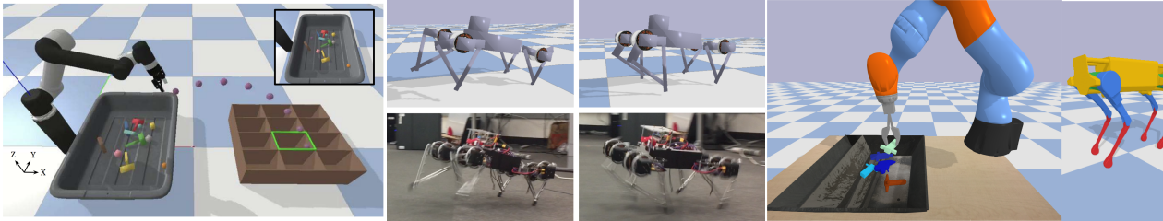
Other Features
Rendering
CPU renderer
TinyRenderer
OpenGL Visualization
Support for VR headsets
HTC Vive, Oculus Rift
Built-in client-server support

Slide 4
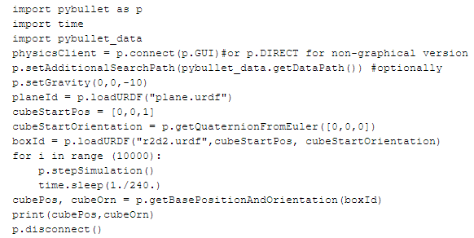
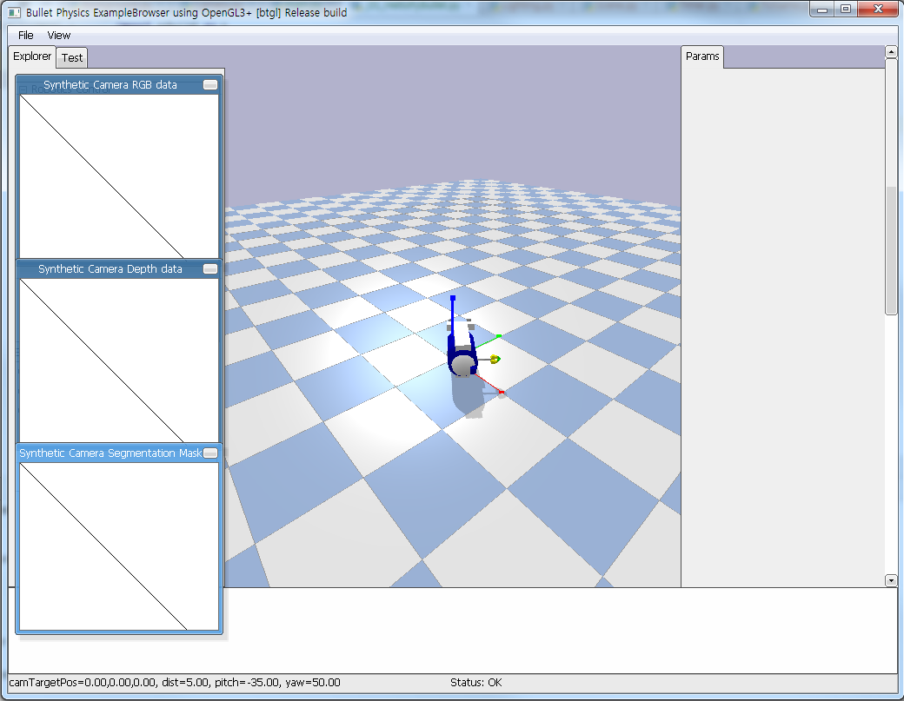
Hello PyBullet World
Pybullet 사용예

Slide 5
Connect, disconnect
First thing to do
Connecting to the physics simulation
PyBullet
Client-server driven API
Client sending commands and a physics server returns the status
Built-in Physics servers
DIRECT
GUI
DIRECT
You cannot access the openGL and VR hardware features
Allows rendering of images using the built-in software renderer through the getCameraImage API
Useful for running simulations in the cloud on servers without GPU
getConnectionInfo
Given a physicsClientId will return the list [isConnected, connectionMethod]

Slide 6
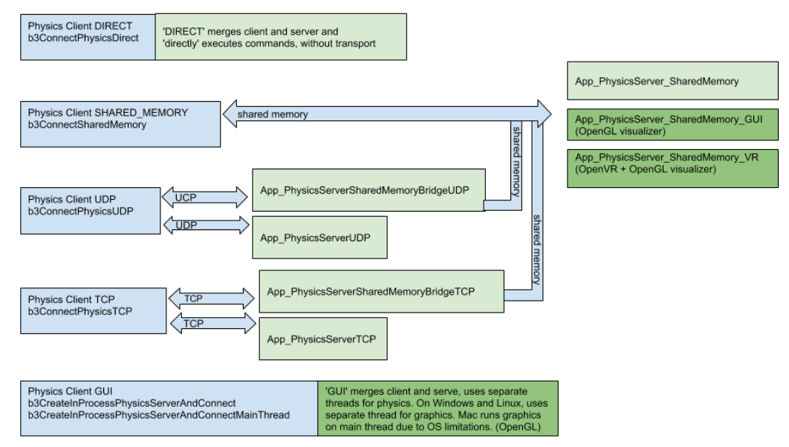
Physics client (blue) and physics server (green) options

Slide 7
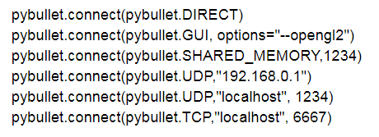
Connect using DIRECT, GUI
DIRECT
Sends the commands directly to the physics engine
No transport layer and no graphics visualization window
Directly returns the status after executing the command
GUI
Creates a new graphics user interface with 3D OpenGL rendering
GUI runs in a separate thread (Windows, Linux) – (OSX: GUI runs in the same thread)
Commands and status messages are sent between PyBullet client and the GUI physics server using an ordinary memory buffer
Another possibility
Connect to a physics server in a different process on the same machine or on a remote machine using SHARED_MEMORY, UDP, or TCP networking.

Slide 8
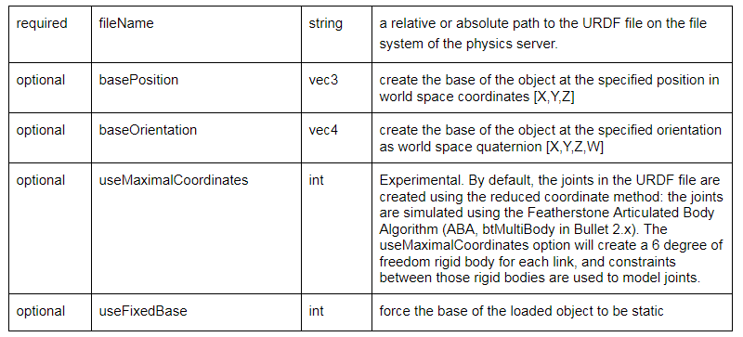
loadURDF, loadSDF, loadMJCF
loadURDF
Sends a command to the server to load a physics model from a universal robot description file
Used by Robot Operating System
Created by WillowGarage and the Open source robotics foundation (OSRF)
Most joints have motors enabled by default preventing free motion
arguments
+ optional arguments: flag, globalScaling, physicsclientId

Slide 9
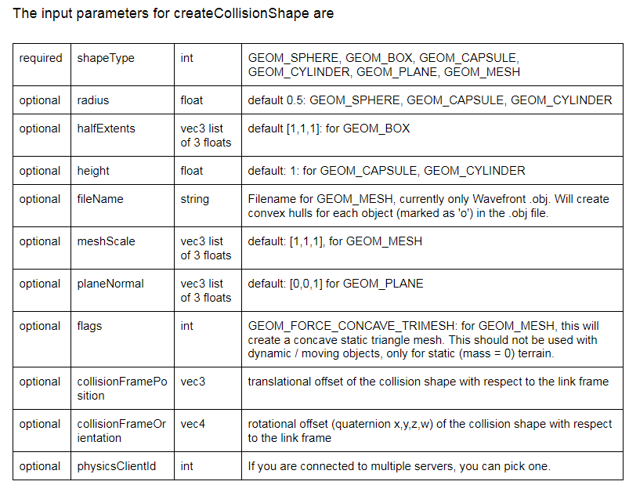
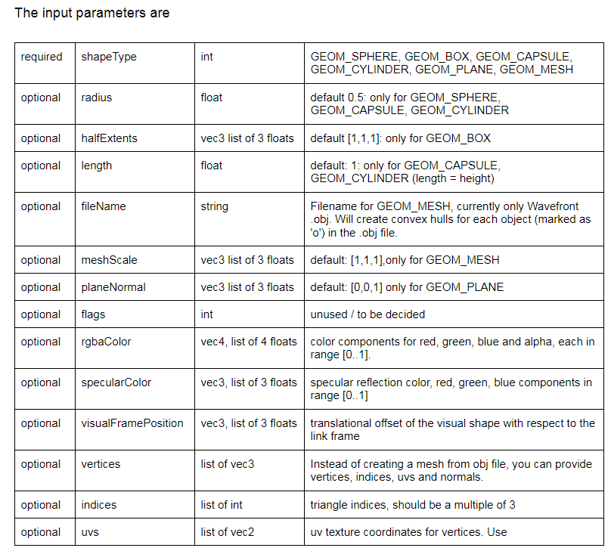
Save and restore / Collision shapes
Save and restore
saveWorld
Create an approximate snapshot of the current world as a pybullet python file
Stored on the server
saveState
saveBullet
restoreBullet
Collision shapes
Easiest way to create stuffs
Loading functions (urdf, sdf, mjcf, bullet)
createCollisionshape
Creates shapes for collision handling
createVisualShape

Slide 10
stepSimulation
Performs all the actiosn in a single forward dynamics simulation step
Collision detection
Constraint solving and integration
Default time step
1/240 sec
Can be changed using the setTimeStep or setPhysicsEngineParameterAPI
setRealTimeSimulation
Run the simulation in real-time by letting the physics server automatically step the simulation according to its real-time clock (RTC)
If you enable this, you needn’t call ‘stepSimulation’

Slide 11
Transforms
Position
Expressed in Cartesian world space coord
Orientations
Quaternions
Euler angles
3x3 matrices
Functions
getQuaternionFromEuler
getEulerFromQuaternion
getMatrixFromQuaternion
multiplyTransforms, invertTransform
Coordinate transformation

Slide 12
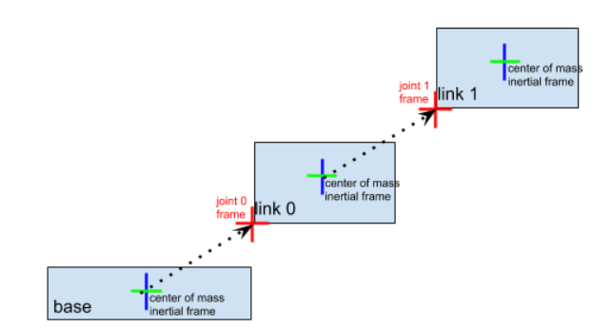
Controlling a robot
Base, joints, links
Urdf has a base
Links are optional
Connected by joints
getNumJoints
getJointInfo

